Slide 1

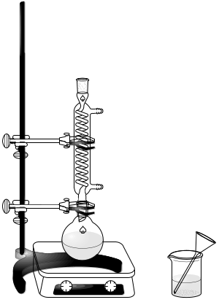
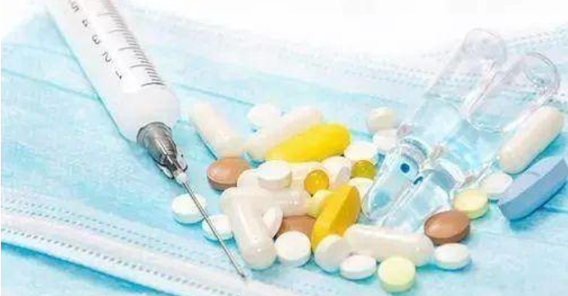

Medicinal Chemistry I
-Organic Chemistry
for 2025 Pharmacy Students in the Sino-British Cooperative Education Program
Tongji School of Pharmacy, HUST
Given by Dr. Luo, Associate Professor
2026 autumn semester

Slide 2
Chapter 1 Introduction
Organic chemistry: what, why, how
What：Organic chemistry is the study of carbon-containing compounds.
Mechanism
Synthesis
Nomenclature
Naming of organic compounds of various functional groups
Physical Properties
B.p., m.p., density, water solubility, etc. as determined by Intermolecular attractions
Chemical Properties
Reactions of organic compounds with various functional groups
Structure
electrons, atoms, bonds, organic molecules (skeleton + functional groups)

Slide 3
Why:
Medicinal Chemistry is a chemistry-based discipline that integrates synthetic organic chemistry, pharmacology, biochemistry, molecular biology, and structural biology.
Its primary focus is the design, chemical synthesis, and optimization of bioactive molecules (drugs) to interact with specific biological targets (such as enzymes, receptors, ion channels, or nucleic acids) in order to diagnose, treat, or prevent disease.
Organic Chemistry is the basis for Medicinal Chemistry, Pharmacology, Pharmaceutics, and Drug Design.
Organic chemistry is also a subject of National Postgraduate Entrance Examination.

Slide 4
How: Theoretical Part & Experimental Part
Theoretical (50 class hours)
Chapters | Titles | Class hrs | Given by
Chapter 1 | Introduction | 2 | Dr. Luo
Chapter 2 | Alkanes and Cycloalkanes | 4 | Dr. Luo
Chapter 3 | Stereochemistry | 4 | Dr. Luo
Chapter 4 | Alkenes and Alkynes | 4 | Dr. Luo
Chapter 5 | Conjugated Dienes and Resonance | 4 | Dr. Luo
Chapter 6 | Aromatic Hydrocarbons and Aromaticity | 4 | Dr. Luo
Chapter 7 | Alkyl Halides | 4 | Dr. Luo
Chapter 8 | Alcohols, Phenols, and Ethers | 4 | Dr. Luo
Chapter 9 | Aldehydes and Ketones | 4 | Dr. Luo
Chapter 10 | Carboxylic Acids and Their Derivatives | 4 | Dr. Zhou
Chapter 11 | Reactions of Enolate Ions | 4 | Dr. Zeng
Chapter 12 | Organic Nitrogen-Containing Compounds | 4 | Dr. Gu
Chapter 13 | Heterocyclic Compounds | 4 | Dr. Gu

Slide 5
Experimental (30 class hours)
Experiments | Titles | Class hrs
1 | Extraction, Distillation, and Boiling Point Determination | 4
2 | Recrystallization and Melting Point Determination | 5
3 | Synthesis of Cyclohexene and its Property Test | 5
4 | Synthesis of n-Butyl Acetate | 5
5 | Synthesis of Binaphthol and Thin-Layer Chromatography | 5
6 | Synthesis of Triphenylmethanol and its Property Test | 6

Slide 6


Grading:
1 | Attendance | 10%
2 | Homework | 10%
3 | Final Exam | 50%
4 | Lab Reports | 10%
5 | Experimental Theory Test | 10%
6 | Experimental technique Test | 10%
QQ community for Q&A
HUST curricula platform for homework & learning materials

Slide 7
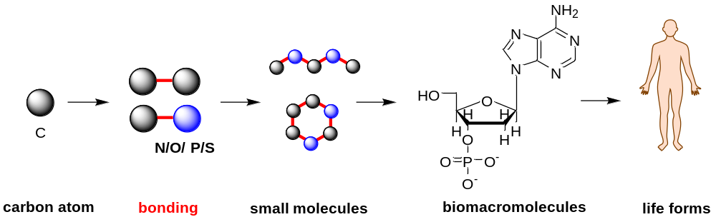
1. Carbon is unique
Organic Chemistry (modern definition): the study of carbon–containing compounds.
Carbon is special among all elements: carbon has a powerful ability to form strong bonds to other carbon atoms and to a wide variety of other elements, resulting in an endless variety of molecules.
The diversity of carbon compounds (> 100,000,000 known) provides the basis for life on Earth.

Slide 8
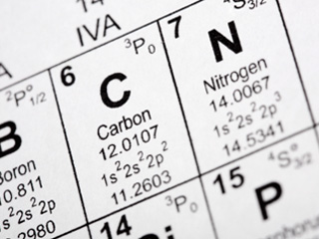
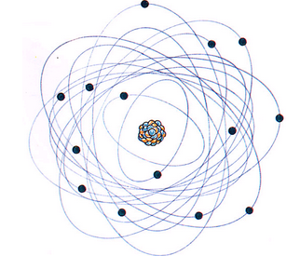
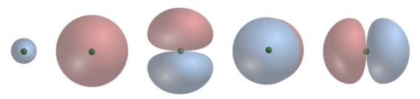
2. Atomic Structure of Carbon
2-1 Structure of the atom: nucleus + electrons
-
Electrons in different orbitals
It is the electrons that take part in chemical bonding and reactions
+
Nucleus: protons + neutrons
2-2 Electronic Structure of the Atom
Electrons bound to nuclei are found in Orbitals (an allowed energy state for an electron).
Atomic orbitals are grouped into different “shells” at different distances from the nucleus (1s, 2s, 2p….).
Most of the common elements in organic compounds are found in the first two rows of the periodic table
1s 2s 2p_{y} 2p_{z} 2p_{x}
the first electron shell
the second electron shell

Slide 9
2-3 Electronic Configuration of the Atom
Build up the electronic configuration of an atom in its ground state:
Pauli exclusion principle: each orbital can hold a maximum of 2 electrons.
Hund’s rule: when there are two or more orbitals of the same energy, electrons will go into different orbitals rather than pair up in the same orbital.
Element | Configuration | Valence Electrons
H | 1s¹ | 1
He | 1s² | 2
Li | 1s²2s¹ | 1
Be | 1s²2s² | 2
B | 1s²2s²2p_{x}¹ | 3
C | 1s²2s²2p_{x}¹2p_{y}¹ | 4
N | 1s²2s²2p_{x}¹2p_{y}¹2p_{z}¹ | 5
O | 1s²2s²2p_{x}²2p_{y}¹2p_{z}¹ | 6
F | 1s²2s²2p_{x}²2p_{y}²2p_{z}¹ | 7
Ne | 1s²2s²2p_{x}²2p_{y}²2p_{z}² | 8
Valence electrons: electrons that are in the outmost shell. Valence electrons are crucial to bonding, because they are not close to the nucleus and therefore only held loosely by the nucleus.

Slide 10
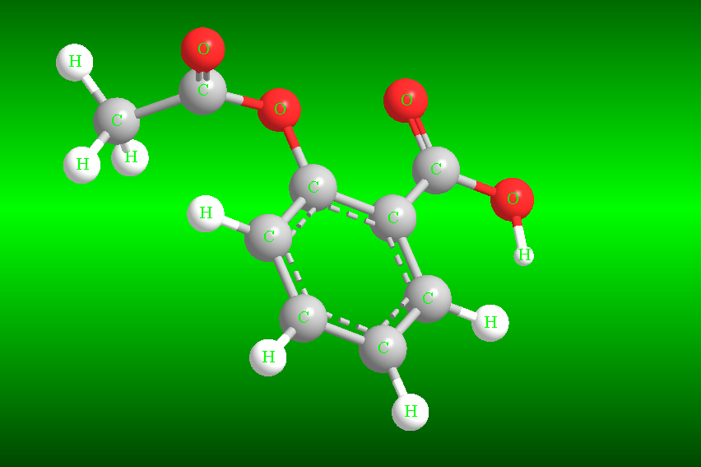

3. Bond Formation: The Octet Rule
Atoms bond together to form molecules.
Aspirin (C₉H₈O₄) - one of the most effective and reliable pain relievers, anti-inflammatory and fever-fighting drugs in the world
3-1 The Octet Rule
Element | Configuration | Valence Electrons
H | 1s¹ | 1
He | 1s² | 2
B | 1s²2s²2p_{x}¹ | 3
C | 1s²2s²2p_{x}¹2p_{y}¹ | 4
N | 1s²2s²2p_{x}¹2p_{y}¹2p_{z}¹ | 5
O | 1s²2s²2p_{x}²2p_{y}¹2p_{z}¹ | 6
F | 1s²2s²2p_{x}²2p_{y}²2p_{z}¹ | 7
Ne | 1s²2s²2p_{x}²2p_{y}²2p_{z}² | 8
A filled shell of electrons is especially stable (2 and 8 valence electrons for the elements in the 1st and 2nd rows of the periodic table, respectively).
Atoms attain a filled shell of electrons by transferring or sharing electrons

Slide 11
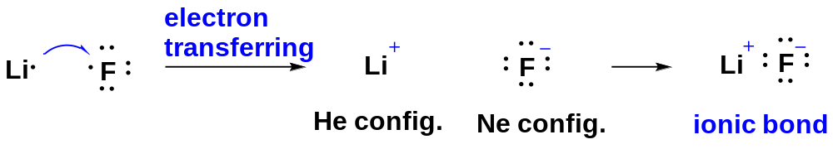
3-2 Ionic Bonding
Some atoms attain noble-gas configurations by transferring electrons from one atom to another.
The resulting ions have opposite charges, and they attract each other to form an ionic bond.
Element | Configuration | Valence electrons
He | 1s² | 2
Li | 1s²2s¹ | 1
F | 1s²2s²2p_{x}²2p_{y}²2p_{z}¹ | 7
Ne | 1s²2s²2p_{x}²2p_{y}²2p_{z}² | 8
Ionic bonding is common in inorganic compounds (for example NaCl) but relatively uncommon in organic compounds.

Slide 12
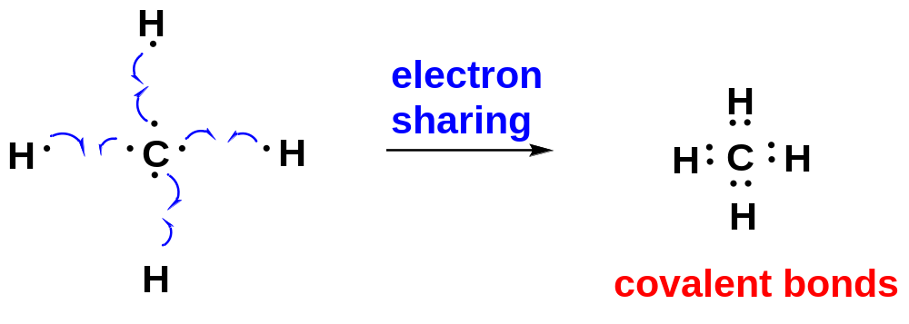
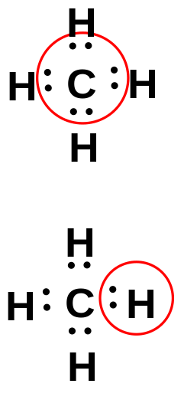
3-3 Covalent Bonding
Covalent bonding is the most common type of bonding in organic compounds.
In covalent bonding, electrons are shared rather than transferred to attain noble-gas configurations.
Element | Configuration | Valence Electrons
H | 1s¹ | 1
He | 1s² | 2
C | 1s²2s²2p_{x}¹2p_{y}¹ | 4
Ne | 1s²2s²2p_{x}²2p_{y}²2p_{z}² | 8
Ne config. satisfied
He config. satisfied

Slide 13
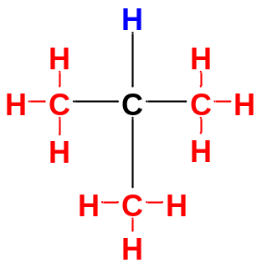
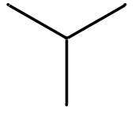
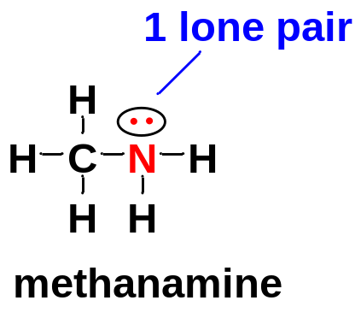
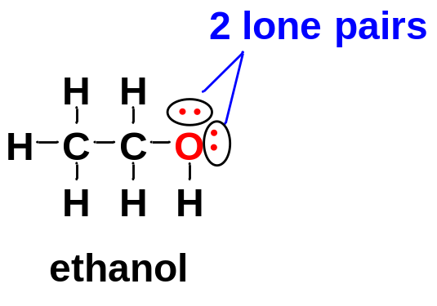
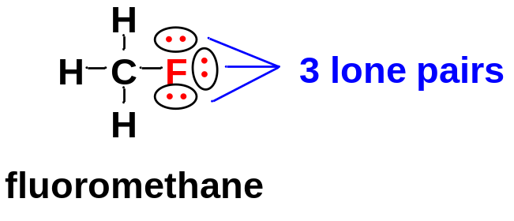
4. Structural Formulas and Lone Pairs
4-1 Structural formulas
Compound | Lewis Structure | Condensed Structure | Line-Angle Formula
isobutane
(CH₃)₃CH
a bonding pair of electrons is symbolized by a dash
4-2 Lone Pair
A pair of nonbonding electrons that are not shared between two atoms are called often called a lone pair.
Lone pairs are sometimes omitted for clarity. However, always do not forget lone pairs, if any.

Slide 14
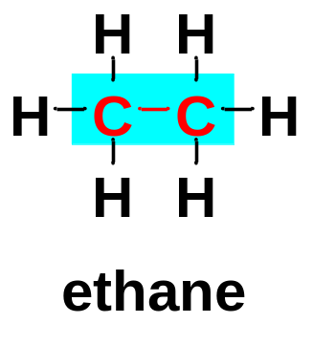
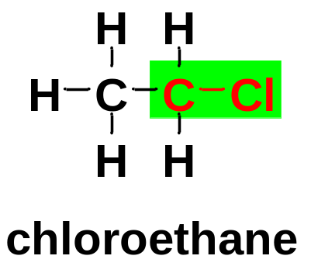
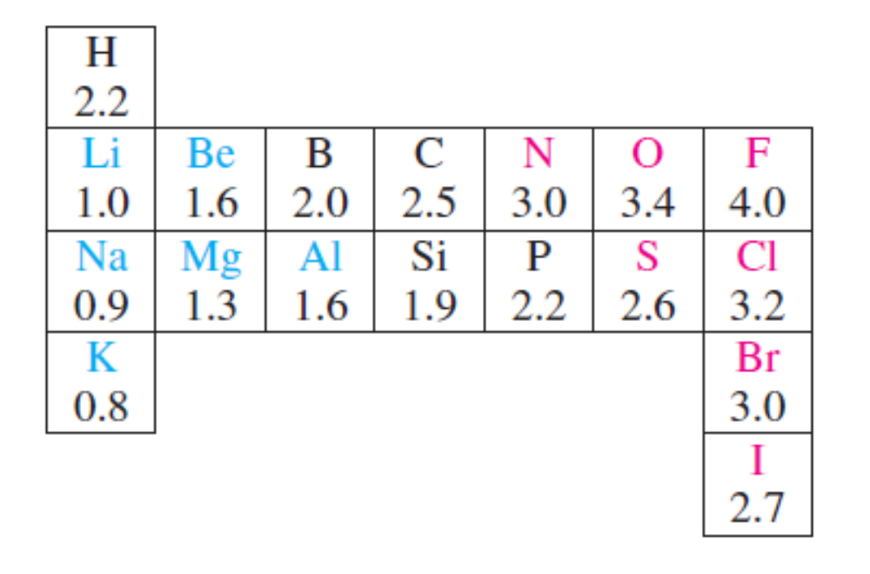
5. Electronegativity and Bond Polarity
5-1 Nonpolar Covalent Bond and Polar Covalent Bond
Bonding between two identical elements → the electrons shared equally between the two atoms → nonpolar covalent bond
Bonding between two different elements → an unequally shared pair of bonding electrons → Polar covalent bond
5-2 Electronegativity
Electronegativities are often used as a guide in predicting the direction of bond polarity.
Electronegativity reflects the ability of a bonding atom to attract electrons toward its direction.
Elements with higher electronegativities generally have more attraction for the bonding electrons.
the Pauling electronegativity scale
The electronegativities increase from left to right across the periodic table

Slide 15


5-3 Bond Polarity
Bond polarity is symbolized by
The atom with the higher electronegativity is the negative end of the dipole, while that with the lower electronegativity is the positive end of the dipole.
a partial positive charge
a partial negative charge
δ⁺
δ⁻
(2.5) (3.2)
C−H bonds are usually considered to be nonpolar because of the negligible difference in the electronegativities of C (2.5) and H (2.2).

Slide 16
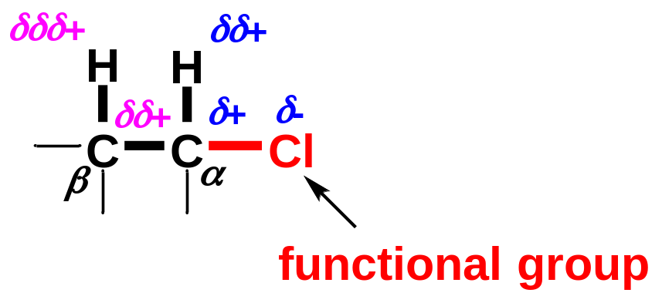
6. Electron-Withdrawing Inductive Effect
Electron-Withdrawing Inductive effect is a type of electronic effect caused by an electronegative atom/group, and passed down through single bonds.
The electronegative atom/group (Cl atom here) withdraws electron density towards its own direction, making the atom bonded to it (α-C here) electron-deficient, and partially positively charged.
The electron-deficient α-C has to withdraw electron density from the atoms (β-C here, for example ) bonded to it to compensate for its electron-deficient situation, making β-C electron-deficient and partially positively charged. The amount of charge on β-C is smaller than that on α-C.
Likewise, β-C withdraws electron density towards its own direction, making β-H slightly electron-deficient.
The range of inductive effect is usually within 3-4 single bonds.

